Slide 1
How to build a search engine(3)
Responding to the queries

Slide 2
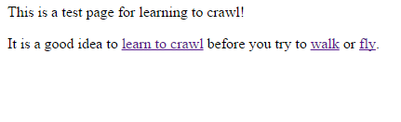
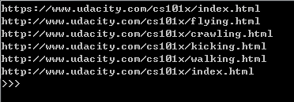
Web crawler
Following the links to find the page
D
E
A
A
B
C
B
Seed URL
None
F
D
Linking can’t response to the query
https://www.udacity.com/cs101x/index.html

Slide 3
Where we are?
Search Engine
Find data
Build an index
Rank page

Slide 4
1. Data Structure
Index = [[[ key, [url1, url2,…]],
[ key, [url1,url2,…]],
…
]
Index:
key
url1
url2
…

Slide 5
2. add_to_index(index, keyword, url)
add_to_index(index, ’udacity’, ‘http://udacity.com’)
add_to_index(index,'computing','http://acm.org')
add_to_index(index,'udacity','http://npr.org')
Index:
key
url1
url2
…
[['udacity', ['http://udacity.com', 'http://npr.org']],
['computing', ['http://acm.org']]]

Slide 6
3. lookup(index, keyword)
Index [['udacity', ['http://udacity.com', 'http://npr.org']],
['computing', ['http://acm.org']]]
lookup(index,‘udacity’)
['http://udacity.com',
'http://npr.org']

Slide 7
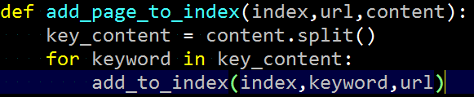
4. add_page_to_index(index,url,content)
<content>.split()

Slide 8
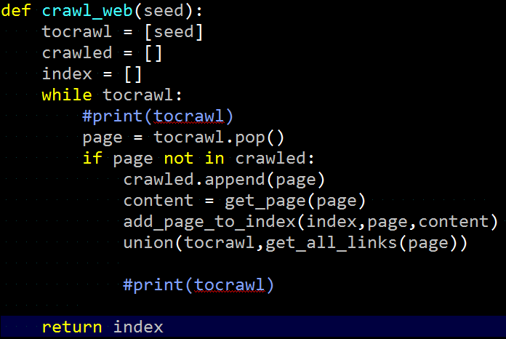
5. Finishing the web crawler

